Slide 1
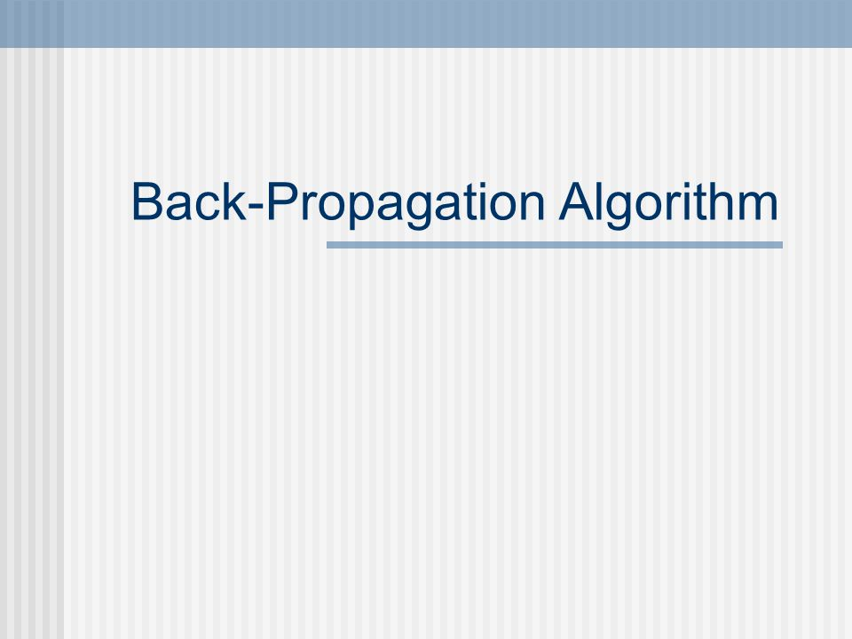
the workhorse of learning in neural networks.
The BPA was originally introduced in the 1970s, but its importance wasn't fully appreciated until a famous 1986 paper

Slide 2
Backpropagation is a very popular neural network learning algorithm because it is conceptually simple, computationally efficient, and because it often works.
[Simplest control system that does its work is the best]
However, getting it to work well, and sometimes to work at all, seem more of an art than a science.
there are no rules to follow to “best” configure a model and training process.

Slide 3
BPA requires the careful configuration of model and choice of hyperparameters.
These choices can be critical, yet there is no foolproof recipe for deciding them because they are largely problem and data dependent.
A hyperparameter is a parameter/ variable need to set before applying a machine learning algorithm onto a dataset for training.

Slide 4
Hyperparameters are divided into two categories:
1.Optimizer Hyperparameters
variables/ parameters related more to the optimization and training process
2. Model Hyperparameters
variables/parameters involved in the architecture or structure of the model.

Slide 5
Optimizer Hyperparameters
Learning Rate: It is a hyperparameter that controls how much we are adjusting the weights of our neural network with respect to the gradient.
Mini-Batch Size: It is a hyperparameter that has an effect on the resource requirements of the training and also impacts training speed and number of iterations.
Number of Training Iteration / Epochs, Acceptable error
Momentum rate, regularization parameter

Slide 6
Model Hyperparameters
Variables/parameters involved in the architecture or structure of the model.
Hidden layers &Number of Hidden Units: Number of hidden layers & neurons in hidden layers in a neural network.
Activation function
Model Specific parameters for the architectures like in CNN Kernel width, in RNN: Choosing a cell type like LSTM Cells, Vanilla RNN cells or GRU Cells and how deep the model is.

Slide 7
Approaches to hyperparameter tuning
Manual: select hyperparameters based on intuition/experience/guessing, train the model with the hyperparameters - an exhausting endeavour.
Grid Search
Random Search
Automated Hyperparameter Tuning: More advanced methods such as Bayesian Optimization and Evolutionary Optimization

Slide 8
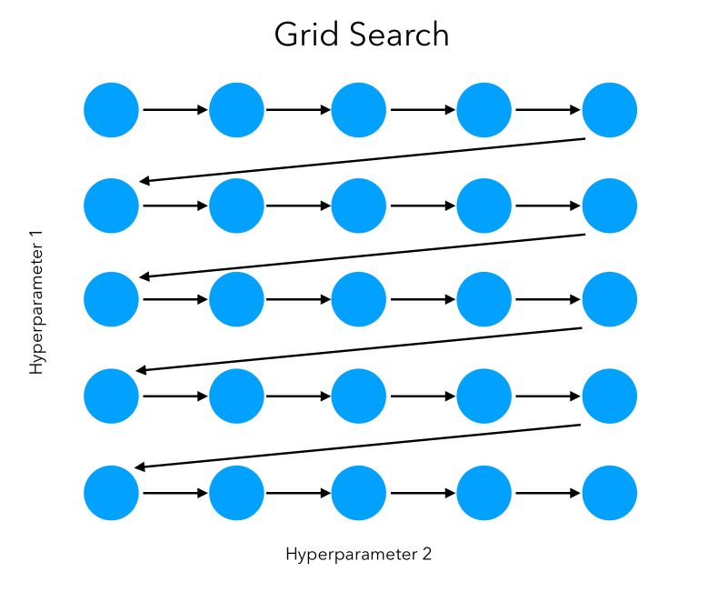
Grid Search: Set up a grid of hyperparameter values and for each combination to train the model and score on the validation data.

Slide 9
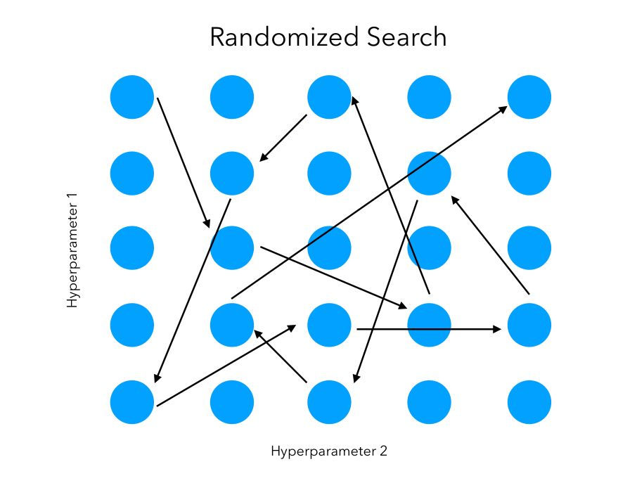
Random search: set up a grid of hyperparameter values and select random combinations to train the model and score.

Slide 10
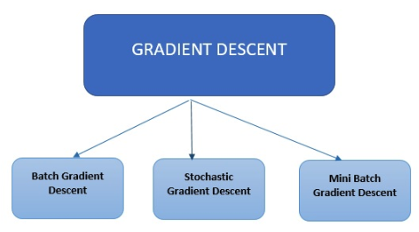

Slide 11
Full Batch/ Batch Gradient Descent:
ANN weights are updated after each Epoch, i.e. weight update is based on training error from all N samples in training data set
Also called per Epoch learning - involves less frequent weight updates, which makes training rather slow[ especially for large data set].
per-epoch learning computes the actual network error of all samples and makes more informed decisions about weight updates.

Slide 12
If there are a million samples in dataset, with Batch/FB Gradient Descent optimization technique all the one million samples will be fed before making a set of changes ( one epoch) , and it has to be done for every epoch until the minima is reached. So computationally very expensive
Stochastic Gradient Descent(SGD) uses only a single sample, i.e. a batch size of ONE, randomly selected, to perform each iteration.
The sample is randomly shuffled and selected for performing the iteration.

Slide 13
SGD(Stochastic gradient Descent) also called per-Pattern mode/Sample-by-sample/Online
the whole sequence of forward and backward computation is performed resulting in weight adjustment for each pattern
ANN weights are updated every time a training sample is presented to the network
During per-pattern learning, it is important to present the examples in random order.

Slide 14
only one data point for updating parameters, SGD is heavily affected by Outliers.
while randomly choosing data points, if we encountered an Outlier, then it will take some more extra updates to get back on its track of convergence.
imagine if it is again encountered an outlier which will throw it off the track.
SGD is sensitive to outliers.
Chances of overfitting in SGD is less

Slide 15
Overfitting happens when the model instead of learning how to answer the question, remembers the answer to the question, so when a different question of the same concept is asked, it does not perform well.
Overfitting will happen when the model considers the same data points repeatedly, such that its parameters are adjusted according to only those parameters (instead of learning the pattern).

Slide 16
For new data points (test dataset), the error is large.
By choosing different data point for each update we are restricting the model from remembering the answer.
SGD is more generalized and less prone to overfitting.

Slide 17
If SUBSET of the full dataset is used for calculating weight updates, it is called Minibatch gradient Descent.
In Mini batch Gardient descent, training is fast and also has smoother gradient updates then SGD.
Mini batch gradient descent is used in all deep learning applications.
Note: In many books or articles people use the name Stochastic Gradient Descent for the Mini batch gradient descent too.

Slide 18
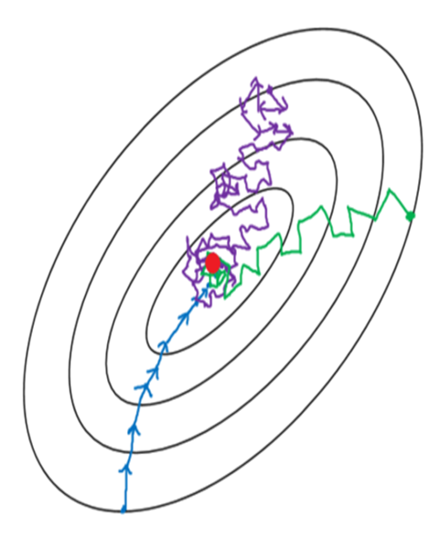
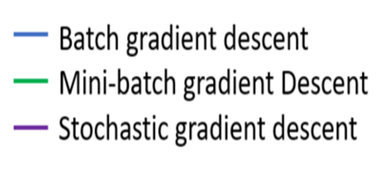

Slide 19
BACK-PROPAGATION LEARNING ALGORITHM
The training involves THREE stages:
1)Feed forward of the input training pattern
2)Calculation and Backpropogation of the
associated error
3) Adjustment of weights/biases

Slide 20
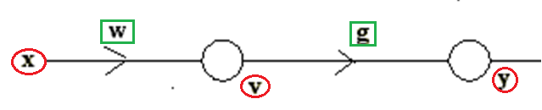
INSTANTEOUS BACK PROPAGATION ALGORITHM

Slide 23
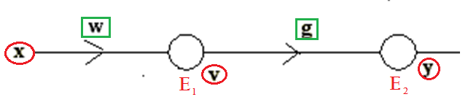

Slide 25
Calculating new weights from input to hidden layer

Slide 27
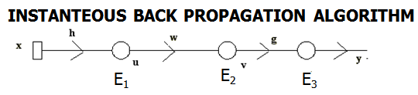
Calculate Error Vectors E₃, E₂ and E₁ logsigmoids activation function at each layer
E₃ = (y^{d} – y)y (1 – y)= (y^{d} – y)f’(net_{o})
E₂ = v (1 – v) E₃ g(t)=f’(net_{h2})E₃ g(t)
E₁ = u (1 – u) E₂ w(t)= f’(net_{h1}) E₂ w(t)
Calculate new weights
g (t +) = g(t) + η E₃ v= g(t) + η E₃ x [f(net_{h2})=v]
w (t +1)=w (t) + η E₂ u=w (t) + η E₂ [f(net_{h1})=u]
h (t +1) = h (t) + η E₁ x

Slide 28
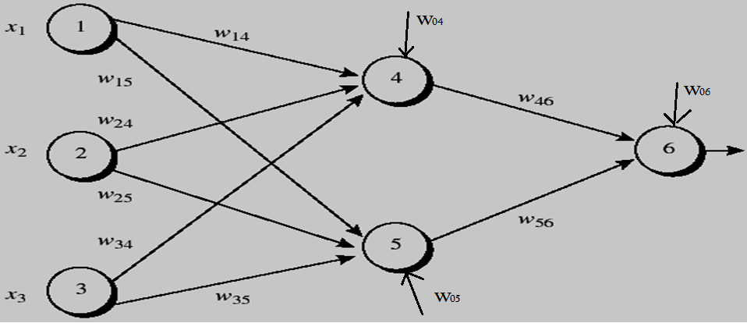
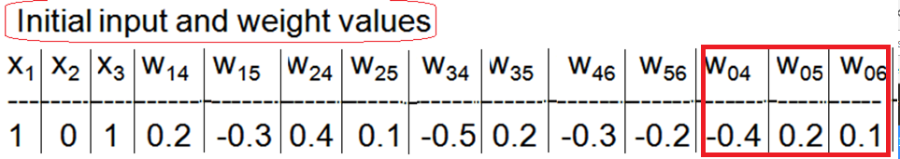
Note Bias inputs at node 4,5,6

Slide 29
learning rate η = 0.9 , first training example is X=(1,0,1) whose class label is 1.
Logsigmoid applied to hidden layer and output layer.
Phase1: Calculate outputs of node 4,5, 6

Slide 30
X = (1,0,1)
Calculate inputs( net₄ ,net₅ ) & outputs (O₄ , O₅ ) at nodes 4 &5
Calculate input ( net₆ ) and output at node 6 (O₆)

Slide 31
net₄ = w ₁₄ x₁ + w₂₄ x₂ + w₃₄ x₃ + w ₀₄ x 1
net₅ = w ₁₅ x₁ + w₂₅ x₂ + w₃₅ x₃ + w ₀₅ x 1
net ₆ = w ₄₆ O₄ + w₅₆ O₅ + w ₀₆ x 1

Slide 32
X = (1,0,1)
Node | Net input to node | Output of node
4 | net₄ =0.2+0-0.5-0.4=-0.7 | O₄ =1/(1+e^{0.7} )=0.332
5 | net₅ = -0.3+0+0.2+0.2=0.1 | O₅ =1/(1+e ^{-0.1})=0.525
6 | net₆ =(-0.3)(0.332) –(0.2)(0.525)+0.1=-0.105 | O₆ =1/(1+e ^{0.105})=0.474

Slide 33
Calculate error vectors at
output (E₂ = e₆ )and hidden layer (E₁ = e₄ , e₅ )

Slide 34
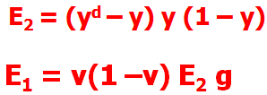
O₆ =0.474
O₅ =0.525
O₄ =0.332

Slide 35
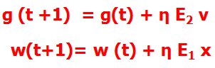
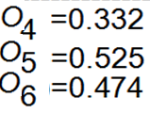
w₄₆ -0.3+(0.9)(0.1311)(0.332)= -0.261
w₅₆ -0.2+(0.9)(0.1311)(0.525)= -0.138
w₀₆ 0.1 + (0.9)(0.1311)(1) = 0.218

Slide 36
w₁₄ = 0.2 +(0.9)(-0.0087)(1) = 0.192
W₁₅= -0.3 +(0.9)(-0.0065)(1) = -0.306
W₂₄= 0.4+ (0.9)(-0.0087)(0) = 0.4
W₂₅= 0.1+ (0.9)(-0.0065)(0) = 0.1
w₃₄= -0.5+ (0.9)(-0.0087)(1) = -0.508
w₃₅= 0.2 + (0.9)(-0.0065)(1) = 0.194
w₀₅= 0.2 + (0.9)(-0.0065) (1) =0.194
w₀₄= -0.4 +(0.9)(-0.0087) (1)= -0.408

Slide 37
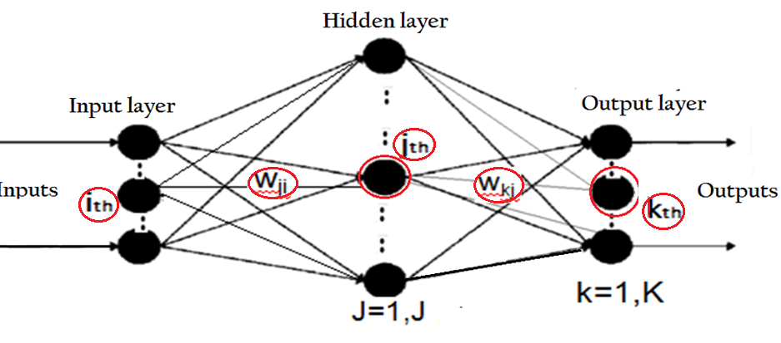
GENERAL BPA
After inputting p^{th} pattern, calculate outputs at all hidden and output nodes.
Compute error for the pattern ‘p’ across all nodes at output layer .
Write Error component at k ^{th} o/p node for p^{th} pattern

Slide 38
4. Write expression for error component at
j^{th} hidden node for pattern p.

Slide 39
GENERAL BPA
5. Update the connection-weight values to the output layer

Slide 40
GENERAL BPA
6. Update the connection-weight values from input to the hidden layer

Slide 41
Repeat steps 1 to 6 for all vector pairs in the training set; this is called an EPOCH.
Run as many epochs as required to reduce the network error E to fall below a Threshold ε:
Write Expression of SSE

Slide 42
Example : BPA
Two dimensional input data( Two features of fruits : Shape, Texture)
Output : Class 1(Banana) Class 2(Orange)
Pattern 1: 0.6, 0.1 target Class 1(Banana)
Pattern 2 : 0.2 , 0.3 target class 2 (Orange)

Slide 43
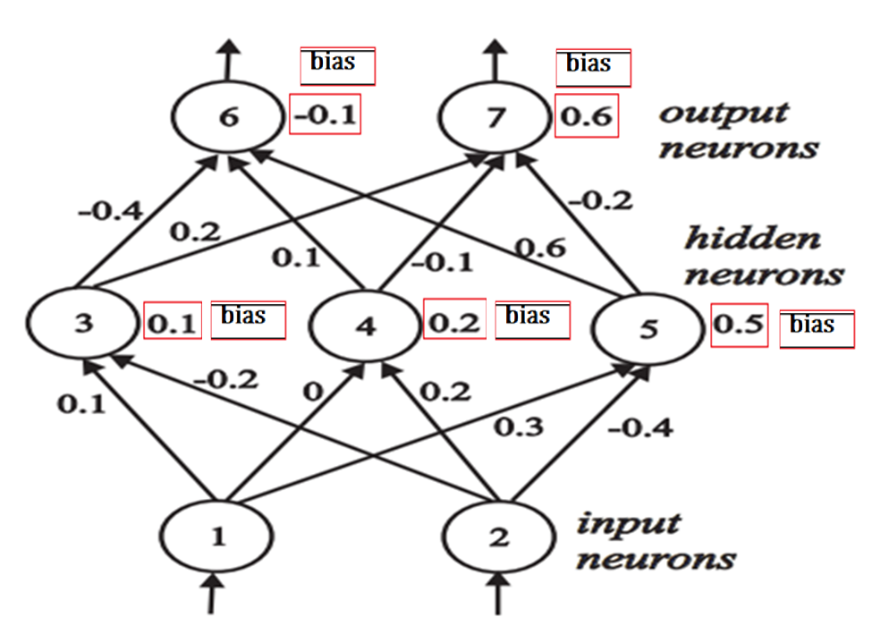

Slide 44
Banana( pattern1: I₁ = 0.6, I₂ =0.1) (d₆) = 1, (d₇ ) = 0
Orange( pattern2: I₁ = 0.2, I₂ =0.3) (d₆) = 0, (d₇ ) = 1
Do Forward Pass, Calculate inputs/outputs at node 3,4,5,6,7

Slide 45
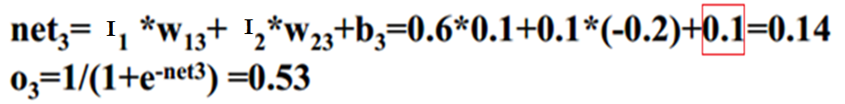
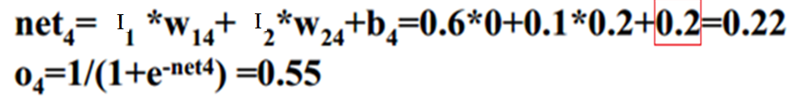
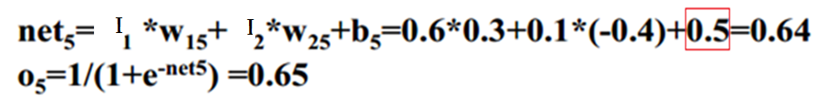
I₁ = 0.6, I₂ =0.1

Slide 46
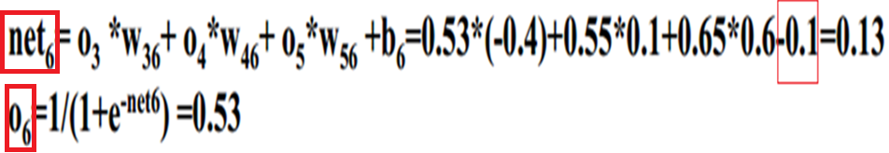
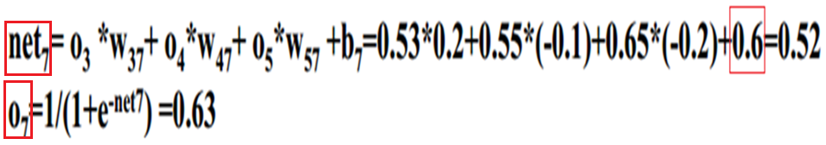
O₃ =0.53 O₄ =0.55 O₅ = 0.65

Slide 47
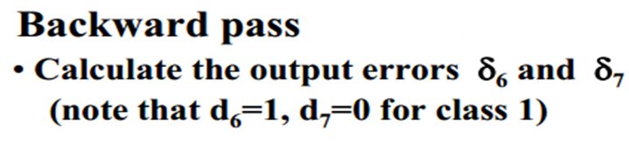
O₆ =0.53
O₇ =0.63

Slide 48
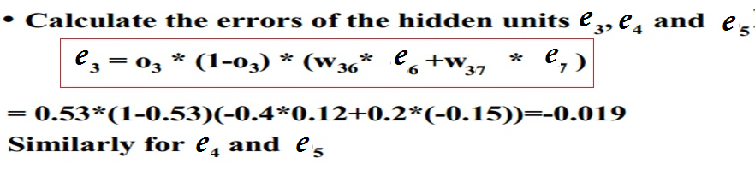
O₃ =0.53 O₄ =0.55 O₅ = 0.65

Slide 49
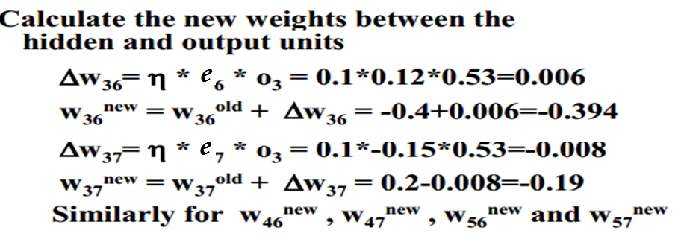
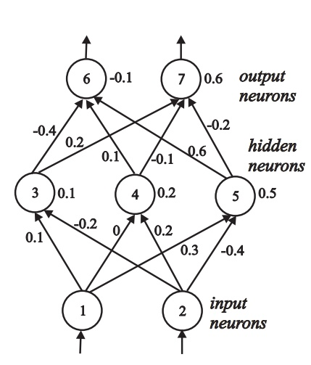
O₃ =0.53 O₄ =0.55 O₅ = 0.65

Slide 50
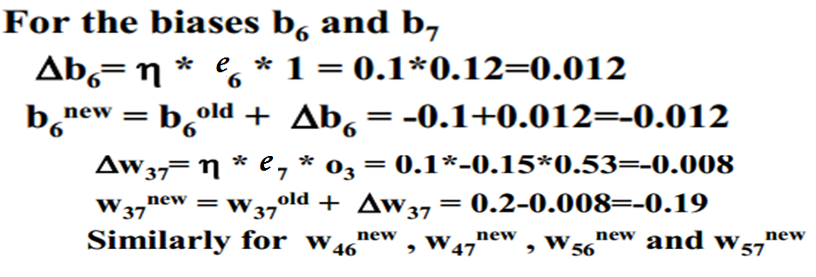

Slide 51
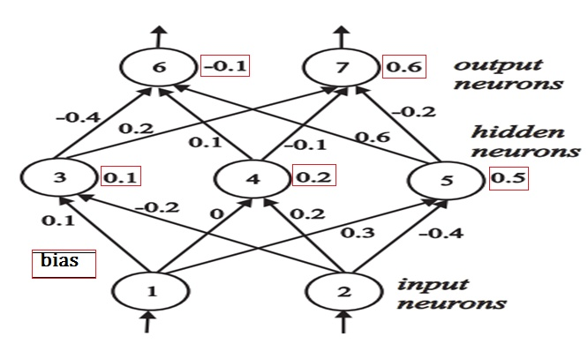
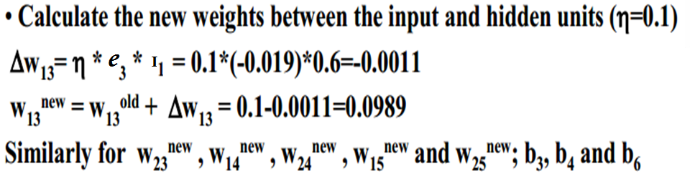
I₁ and I₂ are inputs:
0.6, 0.1

Slide 52
REMARKS ON THE BACKPROPAGATION ALGORITHM
Convergence and Local Minima
May converge to some local minimum
Perhaps not global minimum...
Heuristics to alleviate the problem of local minima
Add momentum
Use adaptive learning rate
Train multiple nets with different initial weights using the same data.

Slide 53
If the change of the cost function gradient between successive iteration steps is not smooth but oscillatory, leading to slow convergence.
One way to overcome this problem is to use a momentum term that smoothes out the oscillatory behavior and speeds up the convergence.
Momentum is a heavy ball rolling down the same hill. The added inertia acts both as a smoother and an accelerator, dampening oscillations and causing us to barrel through narrow valleys, small humps and local minima.

Slide 54
Momentum in Backpropagation
In BPA with momentum, the weight change is in a direction that is a combination of the current gradient and previous gradient.
For each weight
Remember what was added in the previous epoch
In the current epoch
Add on a small amount of the previous Δw

Slide 55
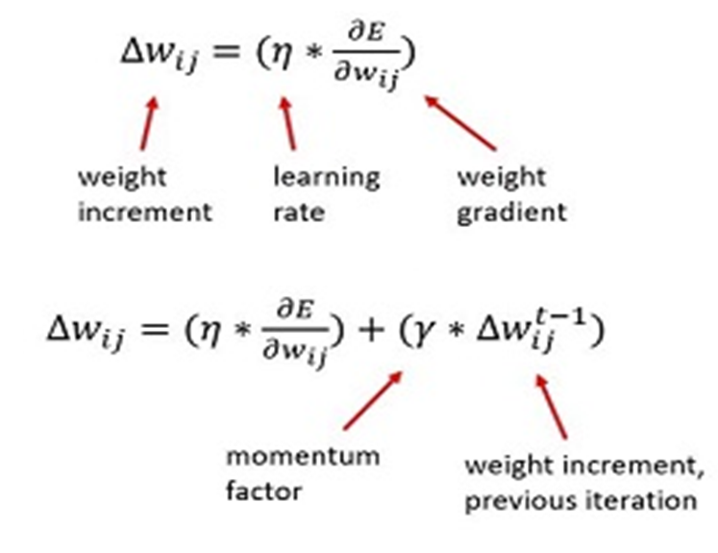
- n^{th} iteration update depend on (n-1)^{th} iteration
- γ: constant between 0 and 1 is called the momentum ( typical value 0.6 to 0.9).

Slide 56
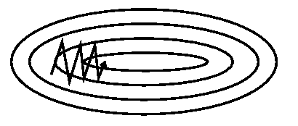
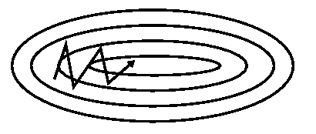
SGD without momentum
SGD with momentum

Slide 57
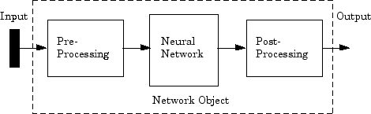
DATA PRE-PROCESSING/POST- PROCESSING
DATA REPRESENTATION

Slide 58
Data Representation
Generally ANNs work on continuous (real valued) attributes.
Attributes of different types[ like age, weight, BP, heart rate] may have different ranges of values which affect the training process.
A data set containing two features, age, and income where age ranges from 0–100, while income ranges from 0–100,000 and higher
put all features into the same scale [PRE-PROCESS] so that none are dominated by another.

Slide 59
Feature Engineering
If data is the crude oil of the 21st century, then feature engineering refines it , and gets a boost in its value.
Feature engineering deduce some hidden insights from the crude data, and make some meaningful features out of it.
Feature engineering requires some good amount of domain knowledge, if it is to be done effectively.
to engineer new features out of Forex data [Forex (FX) is the marketplace where various national currencies are traded], you need some good understanding about how Forex, global economies, and currencies actually work.

Slide 60
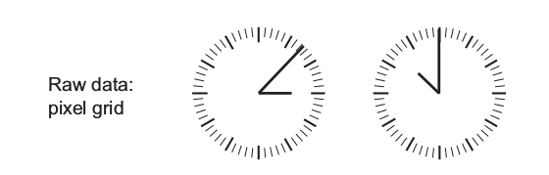
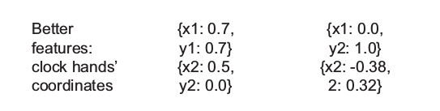
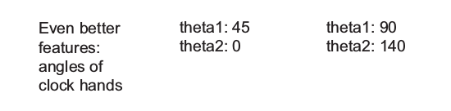
256x256 grid
Good features will let you solve a problem more elegantly, using fewer computational resources.
Good features will let you train an effective model with little data.

Slide 61
General Gudelines for Pre-processing the data :
Smaller values: Try to have all the values between 0 and 1, or -1 to 1.
Homogeneity: All the columns should have values in roughly the same range.
Mean: Normalize in a way that you have a mean of 0 for each column independently.
Standard deviation: Normalize in a way that you have a standard deviation of 1 for each column independently.

Slide 62
Feature Scaling
The goal of applying Feature Scaling is to make sure features are on almost the same scale so that each feature is equally important and make it easier to process by most ML algorithms.

Slide 63
Normalizing Data to unit length
vector [ 3 1 2]
Length of vector = sqrt(3² + 1² +2²)=3.742
Normalized copy of the vector having unit length
x = 3.0 / 3.742 = 0.802
y = 1.0 / 3.742 = 0.267
z = 2.0 / 3.742 = 0.534

Slide 64
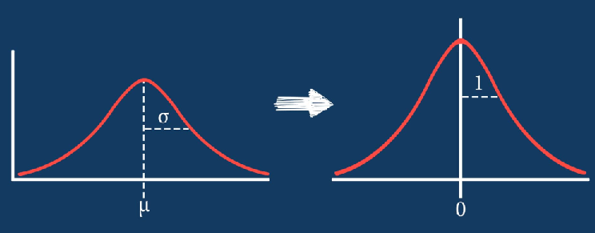
Standardization
It will transform the data to have mean 0 and variance 1, having no units.
Standardization is useful for comparing variables expressed in different units.

Slide 65
Normalizing both input & target data set during pre-processing stage ensures that the network output always falls into a normalized range.
During post-processing stage, the network output is transformed back into the units of the original target data.

Slide 66
NORMALIZATION
Normalizing in the interval [ X _{max-new} , X_{min-new} ]

Slide 67
Postprocessing (Denormalization of output data)
Y_{max} and Y_{min} are max and min activation values of the output neurons
Y_{denorm-max} and Y_{denorm-min} are the maximum and minimum values of denormalised Y

Slide 68
Example : Input : 0-100⁰C, Output-valve opening : 10-100%, both input/outputs have been normalized to ( -1 to 1)
Temp = 68⁰C, Output of network = -0.5.
Find normalized input and denormalized output
Temp_{norm} (-1 to +1) =
Valve opening _{de-norm} =

Slide 69
Normalization is a good technique to use when you do not know the distribution of your data or when you know the distribution is not Gaussian (a bell curve)
Standardization assumes that your data has a Gaussian (bell curve) distribution. This does not strictly have to be true, but the technique is more effective if your attribute distribution is Gaussian.
if you have outliers in your feature (column), normalizing your data will scale most of the data to a small/large interval ?
Standardisation is more robust to outliers, and in many cases, it is preferable over Max-Min Normalisation.

Slide 70
March 15, 2019
To available data of Sales (in millions) vs years (2011 to 2015), linear regression equation is applied to find coefficients for best fit as a = 8.4, b =11.6.
sales = y= ax + b, x =year (0 to 4)
For year 2011, x = 2011 – 2011 = 0,
year 2012, x =1, Year 2013, x = 2, Year 2014,
x=3, Year 2015, x = 4
Given the present year, neural network having one hidden layer with one node, is to be trained to predict the sales in present plus next two years,.

Slide 71
Activation function at hidden and output layers is logsig, ReLu respectively.
Learning rate is 0.1, momentum factor is 0.6.
All initial weights are 0.5 and there is bias only at hidden layer having value 0.5.
All datapresented to ANN is to be preprocessed to lie between 0-1.
Draw the network architecture
(b) Do one forward –backward pass for the year 2013.
©Calculate change in weights and biases after one iteration

Slide 72
year | Rep of year(x) | Normal year-input to NW | Sales=ax+b a=8.4 b=11.6 | Norm sales-output of NW
2011 | 0 | 0 | 11.6 | 0
2012 | 1 | 0.25 | 20.0 | 0.25
2013 | 2 | 0.5 | 28.4 | 0.5
2014 | 3 | 0.75 | 36.8 | 0.75
2015 | 4 | 1 | 45.2 | 1
Draw the architecture

Slide 73
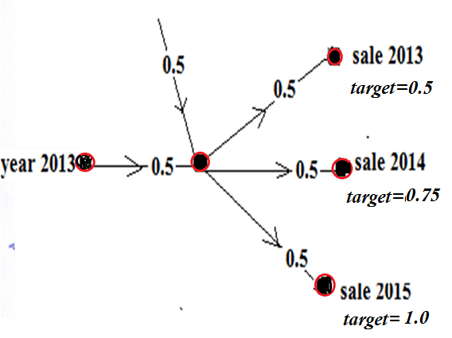
year | Rep of year(x) | Normal year-input to NW | Sales=ax+b a=8.4 b=11.6 | Norm sales-output of NW
2011 | 0 | 0 | 11.6 | 0
2012 | 1 | 0.25 | 20.0 | 0.25
2013 | 2 | 0.5 | 28.4 | 0.5
2014 | 3 | 0.75 | 36.8 | 0.75
2015 | 4 | 1 | 45.2 | 1

Slide 74
Feedforward
H_{in} = 0.5x0.5+0.5x1 = 0.75
H_{out} = 1/[(1+exp(-0.75)] = 0.679
O_{1-in} = O_{2-in} = O_{3-in} =0.5x0.679 = 0.3395
O_{1-out} = O_{2-out} = O_{3-out} = 0.3395

Slide 75
Error Vector at output
ReLu so f’(net)=1
0.5-0.3395=0.1605
0.75-0.3395= 0.4105
1.0-0.3395=0.6605
Error vector at Hidden Node
=0.697 (1-0.679)[0.5(0.1604+0.4105+0.6605)]=0.3141

Slide 76
Change in weights
ΔW_{H-O1} =(0.1)(0.1605)(0.679) =(0.01809)
ΔW_{H-O2} = (0.1)(0.4105)(0.679) =0.02787
ΔW_{H-O3} = (0.1) (0.6605) (0.679)=0.04484)
Δb =(0.1) (0.3141)(1) =0.03141
Δw_{year-H} =(0.1)(0.3141)(0.5)=0.0157

Slide 77
Compre- Dec 2017
Neural network is to be trained using BPA to identify the alphabet presented plus the next alphabet of word “THIS”.
Desired outputs: when T is presented, T at upper node and H at lower node; when H is presented, H at upper node and I at lower node; when I is presented, I at upper node and S at lower node, and when S is presented, S at upper node and zero(0) at lower node.
Input to network is binary representation of alphabets read row-wise from left to right in 3x3 matrix .Outputs of network are decimal equivalent of binary representations of alphabets inputted, divided by 2^{n}, where n is number of pixels to represent alphabet.

Slide 78
Number of Inputs : 9
Number of Outputs : 2
Number of hidden nodes : 1
T = 111010 010 Decimal equivalent of T = 466, desired output = 466/512 =0.910
H = 101111101 Decimal equivalent of H = 381, desired output = 381/512 =0.744

Slide 79
Draw the architecture
Show one forward and backward pass of BPA when alphabet T is presented.
Learning rate is 0.6, all initial weights are set as 0.5. There is one hidden layer with one neuron.
Activation function at hidden layer is tan sigmoid with steepness factor of 2.0[i.e. tanh], activation function at output layer is linear function.

Slide 80
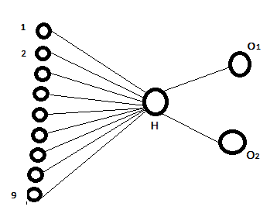
All initial weights 0.5,
T=111010 010
5 pixels are 1, others 0

Slide 81
MST Oct 2018
A single input feedforward neural network is to be trained to learn the unit step response of first order system in time domain described by equation [ 1- e^{-t/τ} ] for three different time constants (τ = 0.5s, 1s, and 2s ), from time t = 0 to 10 sec. There is one hidden layer having two nodes.
Draw the network architecture
How many input nodes?
How many output nodes?
Perform One forward and One backward pass for training the network at t=1 for response at three time constants (τ = 0.5s, 1s, and 2s ), and calculate change in weights.

Slide 82
[Learning rate is 0.2, weights between input and hidden layer is 0.4, between hidden and output layer is 0.2, no bias input. Activation function at the hidden layer is logsigmoid with slope of 2, and at the output layer is ReLu].
Truncate all values to 4 places after decimal.

Slide 83
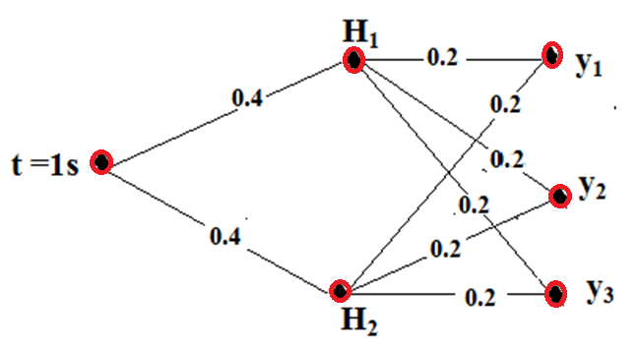
DRAW THE NETWORK ARCHITECTURE
CALCULATE DESIRED OUTPUTS

Slide 84
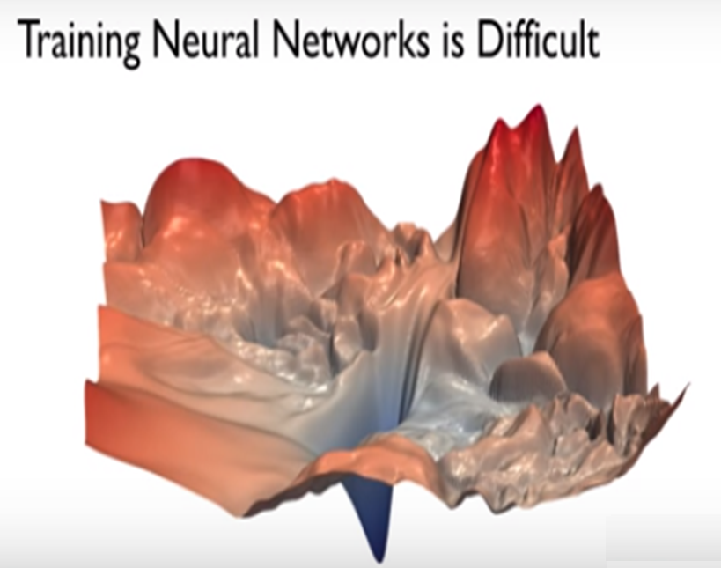

Slide 85
Issues associated with arriving at global minimum
What is a reasonable learning rate to use?
How do we avoid getting stuck in local optima?
What if the loss surface morphology changes?
Even if we can find the global minimum, there is no guarantee that it will remain the global minimum indefinitely.

Slide 86
Examples of loss surface morphology changes
1. Test and training data set have different distribution , So, when applied to new data, the loss surface will different.
Therefore, making the training and test datasets representative of the total data distribution is important.
2. Dynamic nature of data which habitually changes in distribution— like user preferences for popular music or movies, which changes day-to-day and month-to-month.

Slide 87
If learning algorithm is too slow because the input dimension is too high, then use PCA to reduce dimension space to speed up
consider a data set that consist of 100k records. Each records contains information about a person(name, age, height, zodiac sign,country,hair color,weight,obese/not obese).The data set has 8 features describing each person which means it is a 8 dimension data.The feature obese is a categorical variable , that separates the data points into two classes(obese or not obese).

Slide 88
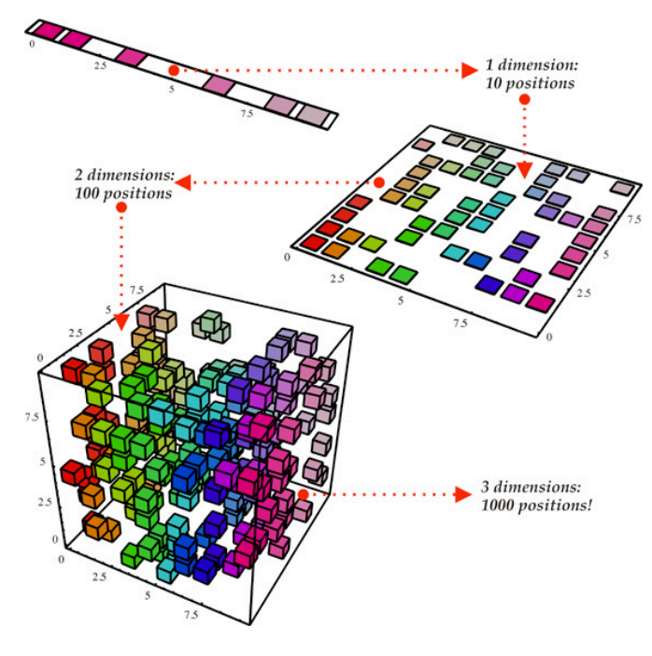
Another common application of PCA is for data visualization.

Slide 89
Overfitting
Underfitting
Regularisation

Slide 90
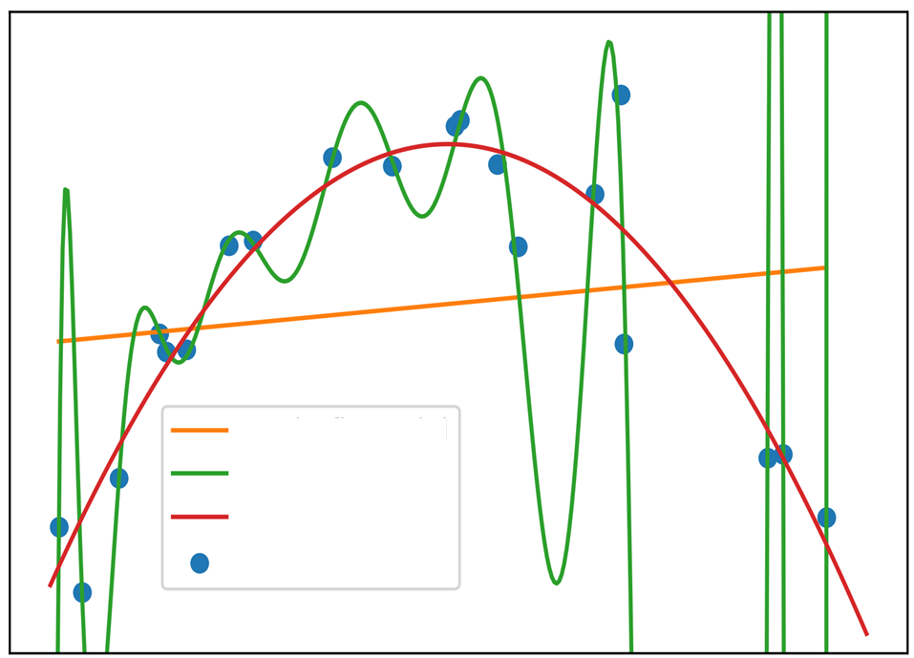
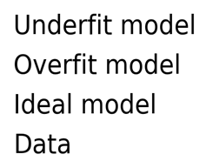

Slide 91
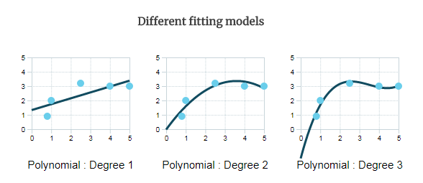

Slide 92
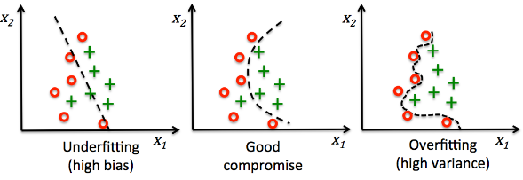
Underfitting/overfitting in classification problems

Slide 93
Over-fitting results in poor generalization.
Network fails to respond well when tested and simulated with an unseen data set.
The network actually memorizes the samples it is trained with, instead of learning to generalize the process to respond to unknown conditions.

Slide 94
A model is overfit when :
Performance on the training data, used to fit the model, is substantially better than performance on a test set
Model cannot anticipate the fluctuations in the new, unseen data of the testing set.

Slide 95
A model is overfit when :
There are a large number of features available, relative to the number of samples
More features there are, greater the chance of discovering a spurious relationship between the features and the response.
When a model overfits the training data, it is said to have high variance(large error on test data).

Slide 96
At the opposite end of the spectrum - if a model is not fitting the training data very well, this is known as underfitting, and the model is said to have high bias.
In this case, the model may not be complex enough, in terms of the features
or
the type of model being used.

Slide 97
Bias—high bias means the model is not “fitting” well on the training set.
This means the training error will be large. Low bias means the model is fitting well, and training error will be low.
Variance—high variance means that the model is not able to make accurate predictions on the test set.

Slide 98
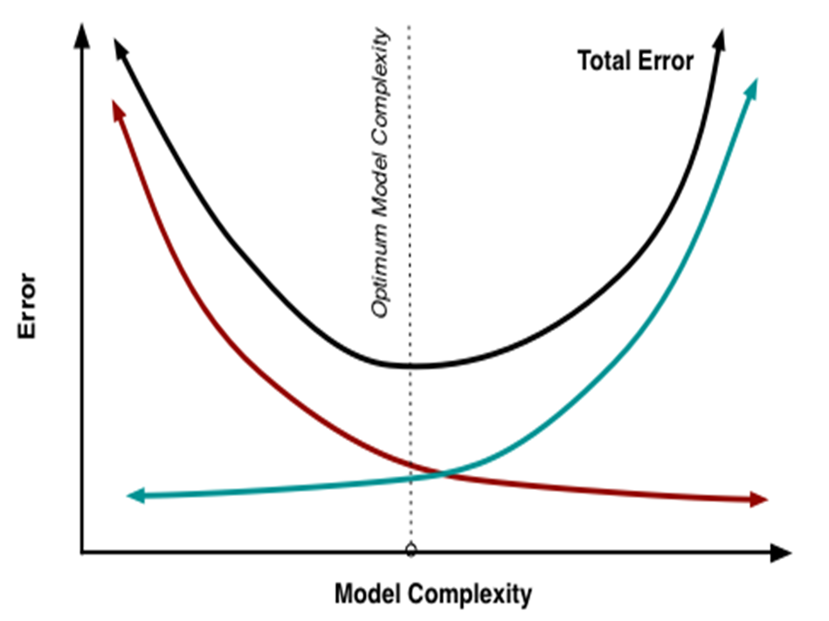
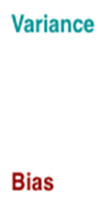
Specifying a network which is just large enough to provide an adequate fit is highly recommended.
Not only will it improve generalization but it will speed up training.

Slide 99
A small data training sample in comparison to the total number of network parameters is one reason for poor generalization.
Small network is unable to over-fit the data.
Large network creates more complex functions.
One way of improving the generalization ability of the network is to use a network that is just large enough to provide an adequate fit.

Slide 100
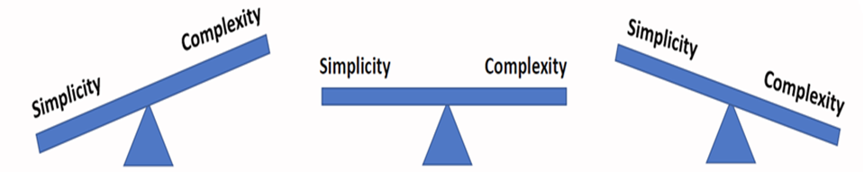
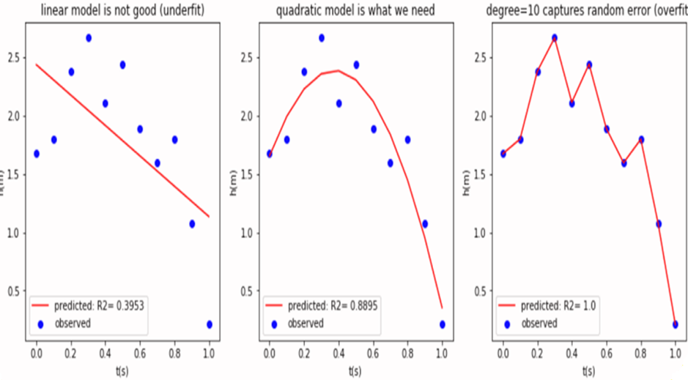
model may be too complex and overfit
or
Model may be too simple and underfit,
either way giving poor predictions.

Slide 101
Regularization-
a technique to avoid over-fitting
It is tuning or selecting the preferred level of model complexity so that ANN models are better at predicting (generalizing).

Slide 102
Methods of Regularization
Modification of the performance function(MSE) which is, by default mse
2) Early stopping
3) Dropout
4)Data augmentation

Slide 103
The general rule of weights in neural networks is that the higher the weights in the neural network, the more complex the neural network. Because of this, neural networks having higher weights generally tend to overfit.
Smaller weights are, in some sense, lower complexity, and so provide a simpler and more powerful explanation for the data, and should thus be preferred.
.

Slide 105
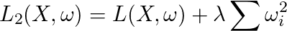
In loss function, include a part of the weights , so that weights are also minimized while training
There are two methods of doing this, they are called the L1 and L2 regularization
Loss function with L1 regularisation
Loss function with L2 regularisation
Regularisation parameter λ > 0 is manually tuned.

Slide 106
Early Stopping
The default method for improving generalization is called early stopping.
This technique is automatically provided for all of the supervised network creation functions
In this technique the available data is divided/split into THREE subsets.

Slide 107

Training Set: used to adjust the weights on the neural network.
Testing Set: used only for testing the final solution to confirm the actual predictive power of the network.
Validation Set: used to minimize overfitting.

Slide 108
Validation data Set is used to minimize overfitting.
Compute the classification accuracy on the validation_data at the end of each epoch.
Once the classification accuracy on the validation_data has saturated/starts increasing, we stop training. This strategy is called early stopping.
Weights of the network are NOT Adjusted with Validation data Set

Slide 109
If the accuracy over the training data set increases, but the accuracy over then validation data set stays the same or decreases, then you're overfitting your neural network and you should stop training.
When the validation error increases for a specified number of iterations, the training is stopped, and the weights and biases at the minimum of the validation error are returned.

Slide 110


Slide 111
Why use the validation_data to prevent overfitting, rather than the test_data?
validation_data is used to evaluate different choices of hyper-parameters such as the number of epochs to train for, the learning rate, the best network architecture, and so on.

Slide 112
Why not set hyperparameters basd on test data ?
If we set the hyper-parameters based on evaluations of the test-data..it's possible we'll end up overfitting our hyper-parameters to the test-data, but where the performance of the network won't generalize to other data sets.
We guard against that by figuring out the hyper-parameters using the validation data.
Then, once we've got the hyper-parameters we want, we do a final evaluation of accuracy using the test data.

Slide 113
That gives us confidence that our results on the testdata are a true measure of how well our neural network generalizes.
validation data is like a type of training data that helps us learn good hyper-parameters.
This approach to finding good hyper-parameters is also known as the hold out method, since the validation data is kept apart or "held out" from the training data.

Slide 114

Published in: IEEE International Conference on Neural Networks
Date of Conference: 28 March-1 April 1993

Slide 115
Most gradient descent variants use the sign and the magnitude of the gradient.
In the Rprop learning algorithm the step-sizes are independent of the absolute value of the partial derivative, depend on sign of the partial derivative.
A step-size, i.e. the update amount of a weight, is adapted for each weight individually.

Slide 116
After calculating update-value for each weight finally each weight is changed by its own update value, in the opposite direction of that weight's partial derivative, so as to minimise the total error function.
if the derivative is positive (increasing error), the weight is decreased by its update-value,
if the derivative is negative, the update-value is added, both represented by the following equation:

Slide 117


Slide 118
The Rprop algorithm makes two significant changes to the back-propagation algorithm.
First, Rprop doesn't use the magnitude of the gradient to determine a weight delta; instead, it uses only the sign of the gradient.
Second, instead of using a single learning rate for all weights and biases, Rprop maintains separate weight deltas for each weight and bias, and adapts these deltas during training.

Slide 119
Two main advantages over back propagation:
1. Training with Rprop is often faster than training with back propagation.
2. RPROP doesn't require you to specify any free parameter values, as opposed to back propagation which needs values for the learning rate (and usually an optional momentum term).
The main disadvantage of Rprop is that it's a more complex algorithm to implement than back propagation.

Slide 120


